Slide 1

ENGLISH PRESENTATION REQUESTS

Slide 2
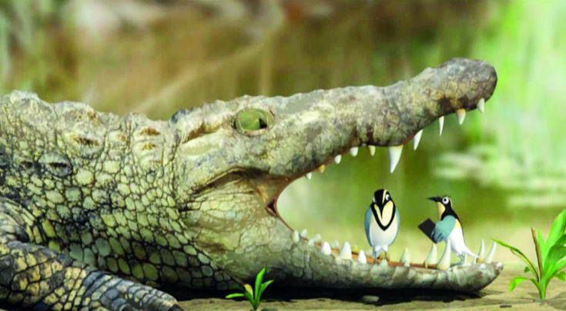
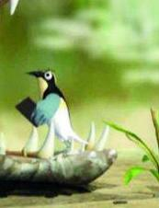
Crocodile
The main focus of the photo is a crocodile and two birds in the bottom of it`s mouth. It looks like the birds are cleaning the crocodile`s teeth. It`s possible
that the crocodile has food in it`s teeth. I really like this photo because one of the birds is taking a picture with it`s “phone”.
Phone

Slide 3
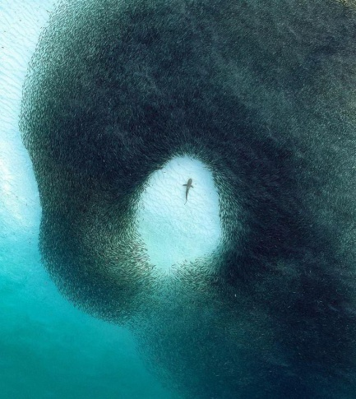
Shark
The main focus of the photo is a shark surrounded by a school of fish. It’s possible that the shark is trying to eat the fish. I really like this photo because I like the sea.

Slide 4
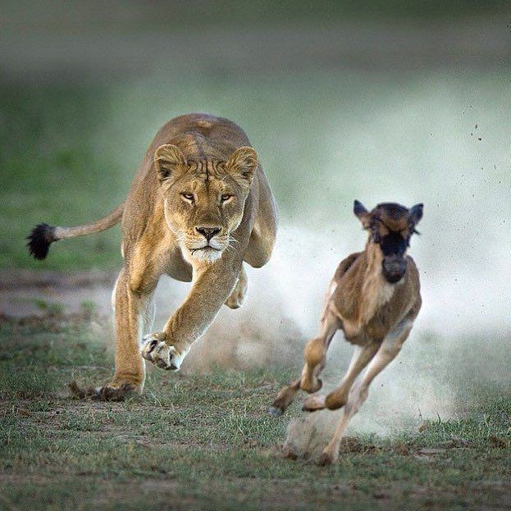
Lion
The main focus of the photo is a lion and a calf. It seems as if they are running quickly because the predator, which is the lion, is going to catch the calf, which is its prey. At the bottom and in the background, there is some grass. In the foreground, dust is coming because they are fast.

Slide 5
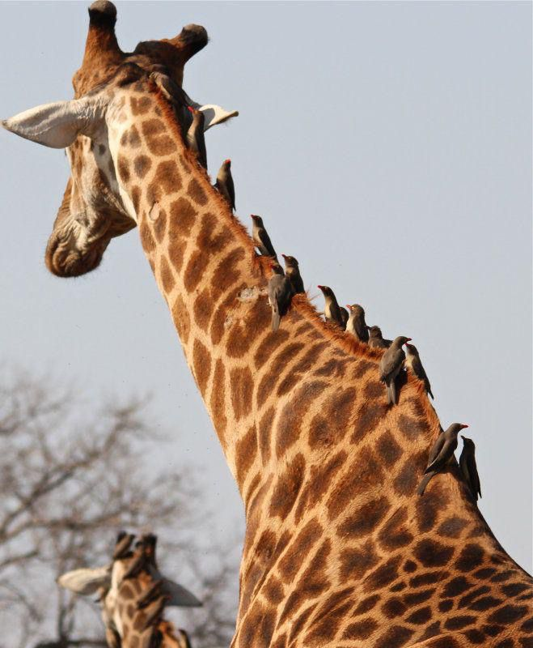
Giraffe
The main focus of the photo is a giraffe with some birds on top of it’s neck. In the background, there’s a tree and another giraffe. It’s possible that the birds are cleaning parasites off the giraffe.

Slide 6
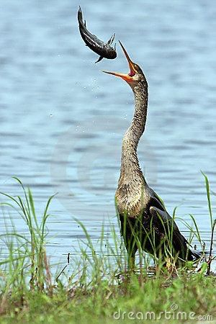
Bird
The main focus of the photo is an anhinga bird with its neck extended to catch a fish thrown in the air. In the back, there’s a lake, and in the front there’s grass. The bird usually eats fish as its prey, so it’s usually near the water.

Slide 7
THANK YOU
Don’t forget to subscribe to VibRibbonOSC😏
For more info call 0799713394

Slide 8
End of slideshow, click to exit.

Slide 9
End of slideshow, Click to exit.
Windows - ▢ X
Squeak Squeak!
Cancel

